Slide 1
OSI & Data Transmission

Slide 2
Network Packets (Frames)
Transmissions are broken up into smaller units or data transmissions called packets
These are small chunks of data and other information
Example
A file (might be an mp3 sound file) is divided into packets.
It does not matter what the transmission is. It could be Word
document, a PowerPoint or an MP3

Slide 3
Packet Structure
Packet Structure
Header
Source address
Destination address
Instructions that tell the computer how to pass the data along (routing)
Reassemble information
Data
Trailer containing error-check information

Slide 4
A simple data packet
Destination ID
Control
CRC
Sender ID
Data
Trailer
Header

Slide 5
Packets and OSI
After transmission is divided into packets extra information required to make sure it all goes back together correctly. The OSI model helps to look after this.
The OSI model also provides much more information which is included with each package.
Transmission of data packets occurs in both directions. Peer layers communicate back and forth when a data packet is being sent.

Slide 6
Transmission
Data transfer begins at the application layer of the source device and each OSI layer adds header and/or trailer information to help ensure efficient, error free transfer of data
The destination device receives the data and the data is transferred up through the layers.
Each strips the information added by its peer layer and moves the remaining data to the next layer.
Eventually, the data is returned to its original form at the application layer.

Slide 7
Application Layer
serves as an interface between user applications and network services, such as electronic mail.
Provides services to support user applications, such as file transfer, database access, and e-mail
Not a particular application—but services that are provided to applications
Data input by the user is then sent to the next layer, the presentation layer

Slide 8
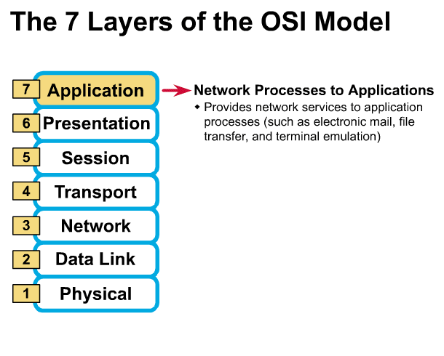
The Application Layer
Gives end-user applications access to network resources
Where is it on my computer?
Workstation or Server Service in MS Windows
³

Slide 9
Presentation Layer
Translates data between the format the network requires and the format the application expects
Responsible for encrypting data, changing or converting the character set and interpreting graphic commands
Manages data compression to reduce number of bits to be transmitted
Header information is added by presentation layer protocols.

Slide 10
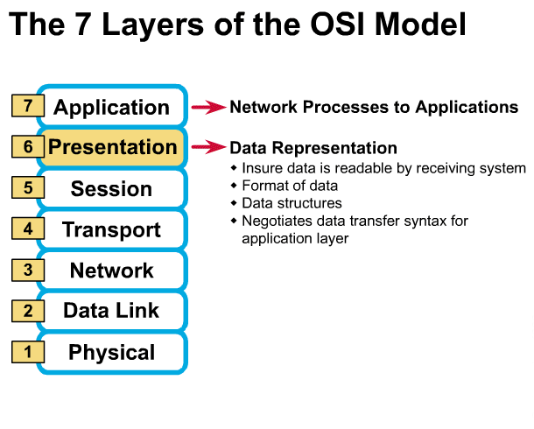
Presentation Layer
³

Slide 11
Session Layer
Responsible for establishing and maintaining communications between two nodes on the network
Allows applications on separate computers to share a connection (called a session)
Provides data synchronization and checkpointing so that if there is a network failure only the data sent after the checkpoint must be resent
Provides name recognition and security needed to allow two applications to communicate

Slide 12
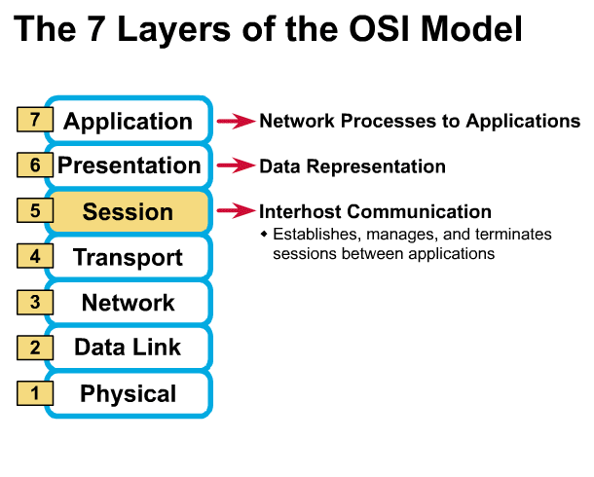
Session Layer
Allows applications to maintain an ongoing session
Where is it on my computer?
Workstation and Server Service (MS)
Windows Client for NetWare (NetWare)
³

Slide 13
Transport Layer
Ensures data is delivered error-free in sequence and without duplication or loss
Breaks large packets from the Session layer into segments to be sent to the receiving computer
Adds sequencing information to segments
Reassembles the segments into messages
Sends acknowledgement to sending computer

Slide 14
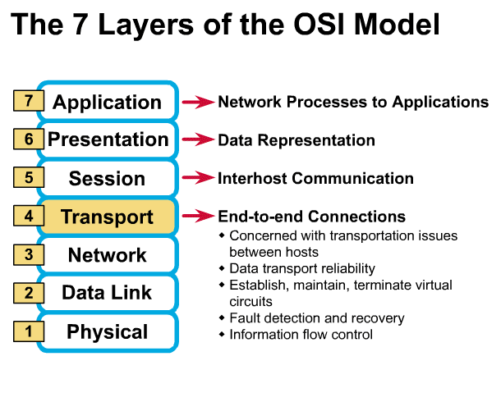
Transport Layer
Provides reliable data delivery
It’s the TCP in TCP/IP
Receives info from upper layers and segments it into packets
Can provide error detection and correction
³

Slide 15
Network Layer
Responsible for addressing messages across networks
Translates network logical addresses into physical machine addresses
Breaks large segments into smaller packets
Determines routing across networks
Supports communications between logically separate networks
Routers and gateways (devices that pass data from one network to another) operate in the Network layer

Slide 16
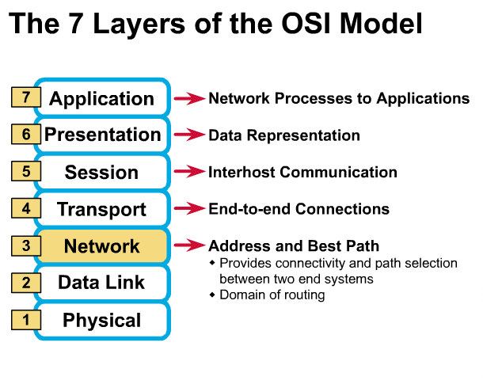
Network Layer
Provides network-wide addressing and a mechanism to move packets between networks (routing)
Responsibilities:
Network addressing
Routing
Example:
IP from TCP/IP
³

Slide 17
Data Link Layer
Media Access Control
Controls the way multiple devices share the same media channel
Defines the method the NAC will use to determine when to send data
Communicates directly with the network adapter card
MAC (physical) address for network adapter cards provide unique identifier for each NAC

Slide 18
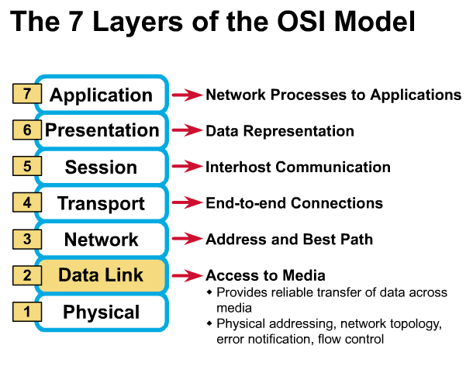
Data Link Layer
Places data and retrieves it from the physical layer and provides error detection capabilities
³

Slide 19
Data Link Layer
Logical Link Control
Uses error check algorithm (FCS) to verify that data is received correctly
Ensures that the rate of transmission is appropriate for the receiving computer
Provides the link between the Data Link layer and the Network layer

Slide 20
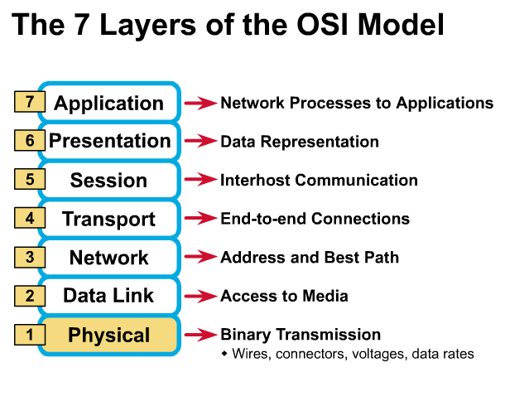
Physical Layer
Determines the specs for all physical components
Cabling
Interconnect methods (topology / devices)
Data encoding (bits to waves)
Electrical properties
Examples:
Ethernet (IEEE 802.3)
Token Ring (IEEE 802.5)
Wireless (IEEE 802.11b)
³

Slide 21
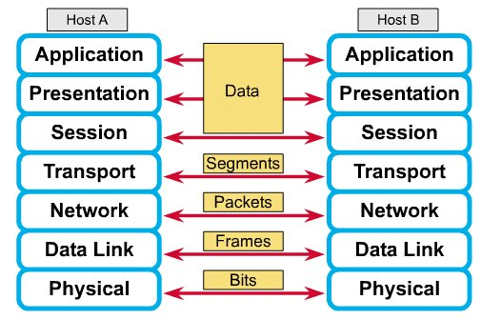
How Does It All Work Together
Each layer contains a Protocol Data Unit (PDU)
PDU’s are used for peer-to-peer contact between corresponding layers.
Data is handled by the top three layers, then Segmented by the Transport layer.
The Network layer places it into packets and the Data Link frames the packets for transmission.
Physical layer converts it to bits and sends it out over the media.
The receiving computer reverses the process using the information contained in the PDU.
²

Slide 22
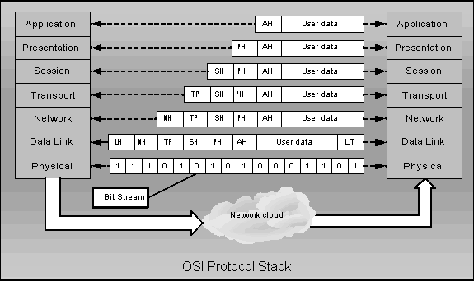
Packet Creation Process I

Slide 23
Packet Creation Process II
Data
Data

Slide 24
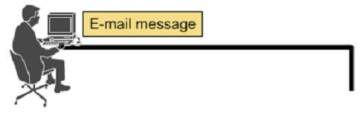




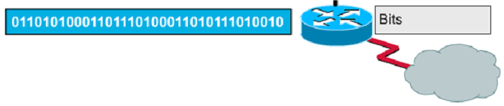
Encapsulation example: E-mail

Slide 25
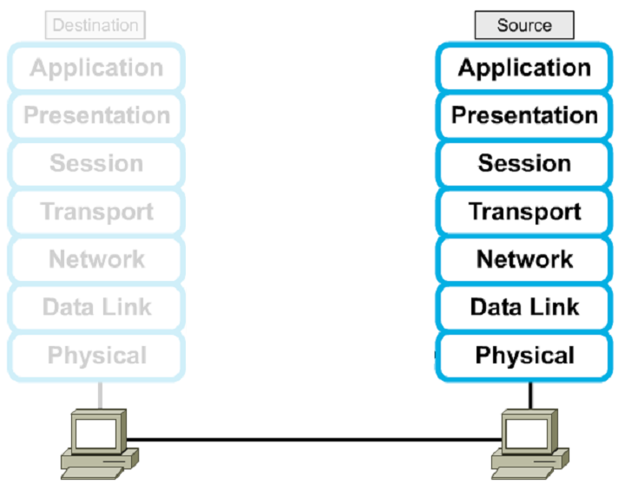




Encapsulation

Slide 26
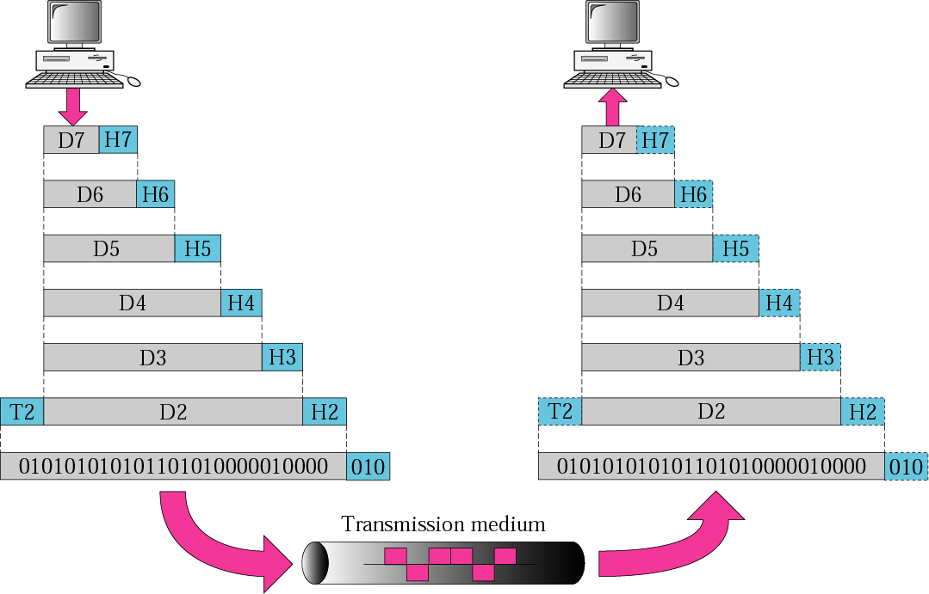
Figure 2.3 An exchange using the OSI model

Slide 27
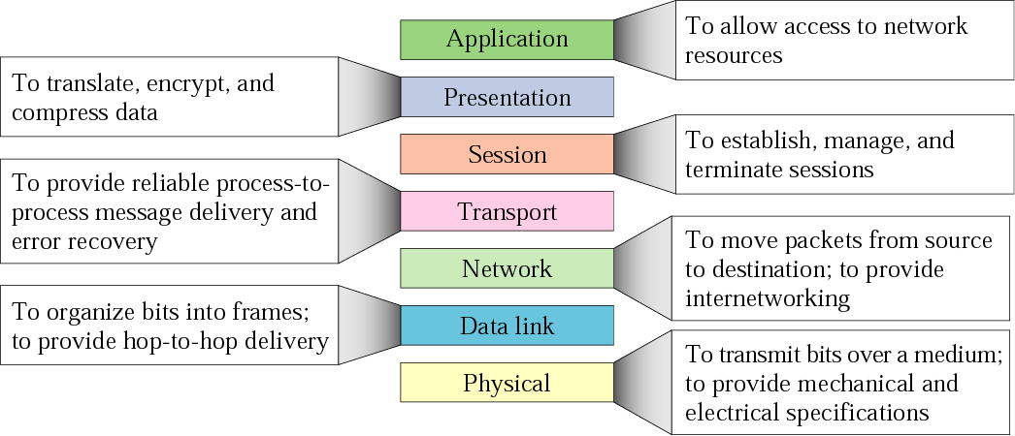
Figure 2.14 Summary of layers

